Slide 1


City of Jacksonville’s Subcommittee on Resiliency of Infrastructure and Continuity of Operations
August 27, 2020
On December 15, 2017,
CH2M HILL Engineers, Inc., became a wholly owned subsidiary of Jacobs Engineering Group Inc.

Slide 2
Agenda
JEA Resilience Program Overview and Status
Coastal and Riverine Flood Modeling and Climate Scenarios
Risk Assessment: calculating avoided costs for direct asset damage
Adaptation Strategies and Economic & Benefit-Cost Analysis
Q/A

Slide 3
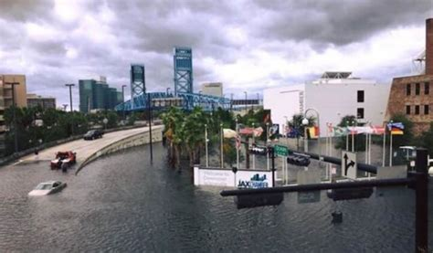
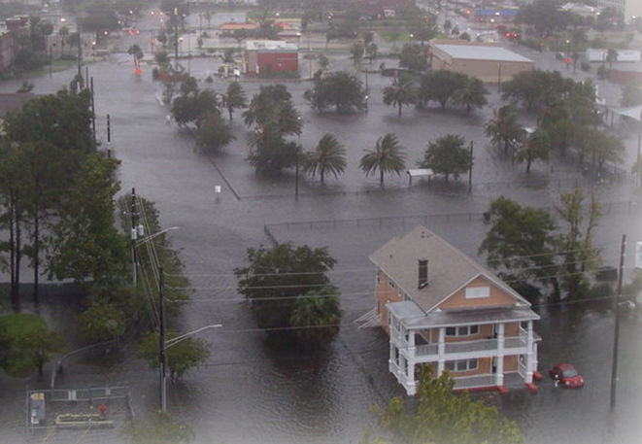
Designing for Resilience: JEA’s Response to Hurricanes Matthew (2016) and Irma (2017) Flooding
Source: www.s.w-x.co/wu/jax-flooding-sheriff-9.11.17
Source: www.s.w-x.co/wu/jax-flooding-sheriff-9.11.17

Slide 4
JEA’s Resiliency Program Goals
Understand Current and Future Severe Weather and Climate Risks
Identify JEA Water, Wastewater, Reclaimed Water and Chilled Water System Vulnerabilities to Identified Risks
Update Design and Construction Standards for Enhanced Reliability
Develop Adaptation Strategies (System Enhancements/Upgrades)
Develop Resilience Plan as Roadmap to Implement Strategy
4

Slide 5
JEA Operates over 1,700 Facilities across a 4-County Region with nearly 500,000 Customer Accounts
Water Reclamation Facilities (WRFs)
Wastewater Pump Stations
Water Treatment Plants (WTPs)
Production Wells
Potable Water Booster Stations
Reclaimed Booster Stations
Water Intertie Stations
Chilled Water Plants
11
1,510
38
137
3
3
3
4
5

Slide 6
JEA’s Water/Wastewater System Resilience Plan
(February 2018 – present)
11 Task Orders
  From planning for resilience to facility specific design and regulatory compliance projects
Three Task Orders were focused on resilience planning related activities:
  System Resilience Plan
  Electrical and I&C System Assessment
  Wastewater Treatment Plant and Conveyance System Hydraulic Capacity Assessment

Slide 7
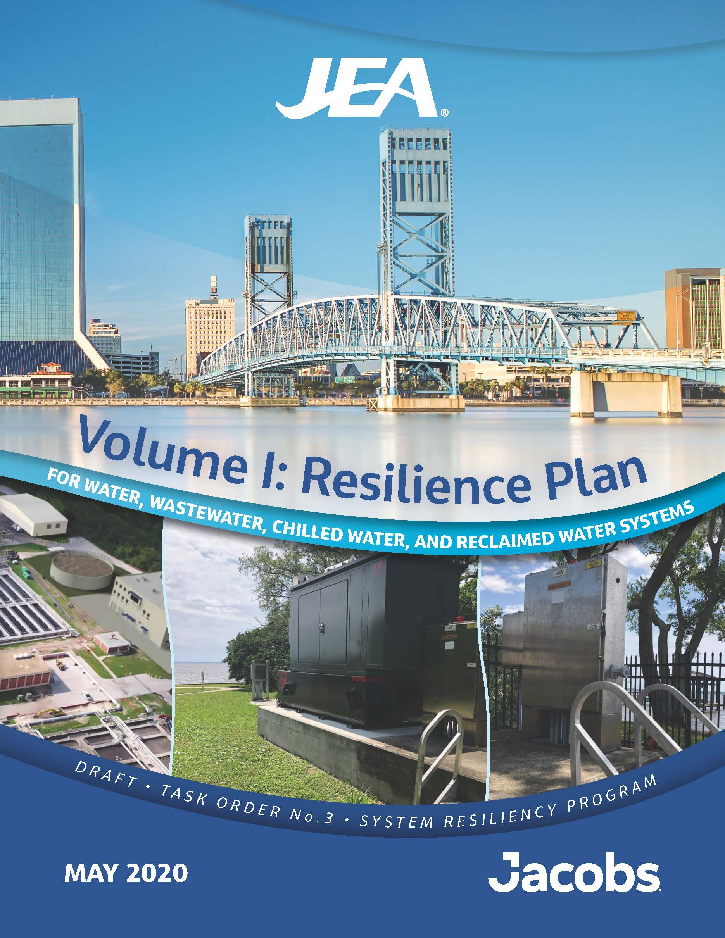
JEA’s Water/Wastewater System Resilience Plan
The System Resilience Plan include the following steps:
  Establish Future Extreme Weather Scenarios
  Perform Surge, Riverine and Inland Flood Modeling
  Perform Vulnerability Assessment
  Risk Analysis of Select JEA Facilities
  Develop Mitigation and Adaptation Strategies
  Perform Economic Cost-Benefit Analysis
  Prioritize Strategies
  Update Design and Construction Standards
  Develop Resilience Plan and Implementation Roadmap
7

Slide 8
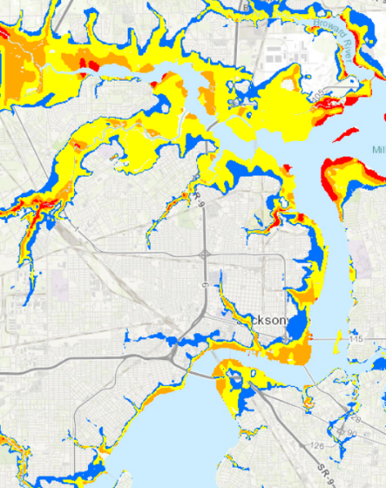
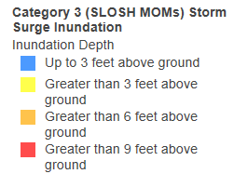
Climate-Based Flood Scenarios

Slide 9
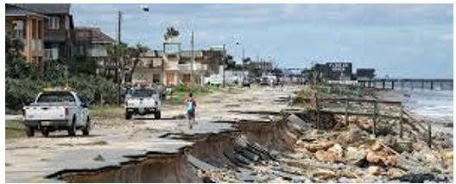
Sea Level Rise and Precipitation Projections, and Recommended Climate Scenarios
Current and Projected Sea Level Rise
  Planning Time Horizons (2040 & 2070)
Current and Future Storm Surge
Current and Projected Rainfall
  Intensity, Duration, and Frequency (IDF)
  Greenhouse Gas (GHG) emission scenarios: RCP 6.0 and RCP 8.5
Climate scenarios
  100-yr storm in 2040 with low GHG 5. 25-yr storm in 2040 with low GHG
  100-yr storm in 2040 with high GHG 6. 25-yr storm in 2070 with high GHG
  100-yr storm in 2070 with low GHG 7. 500-yr storm in 2070 with high GHG
  100-yr storm in 2070 with high GHG 8. 100-yr storm in 2070 with no storm surge

Slide 10
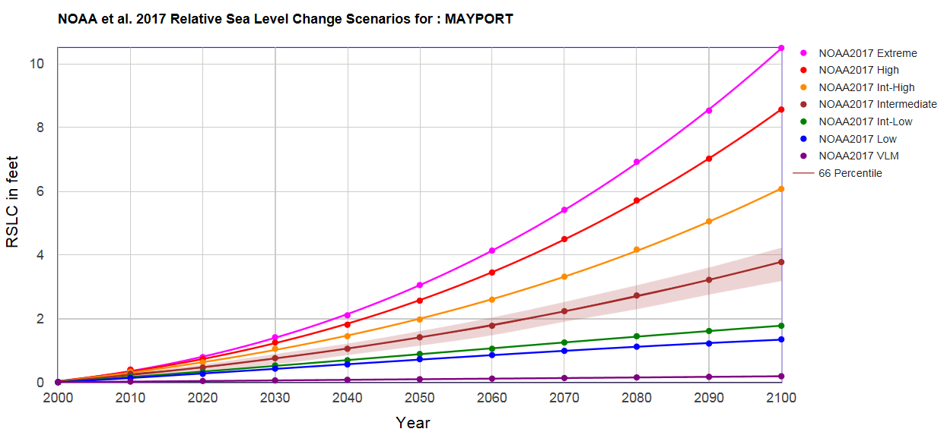
Sea Level Rise: Updated Projections
2100
4-9 feet
2070
2-4.5 feet
2040
1-2 feet

Slide 11
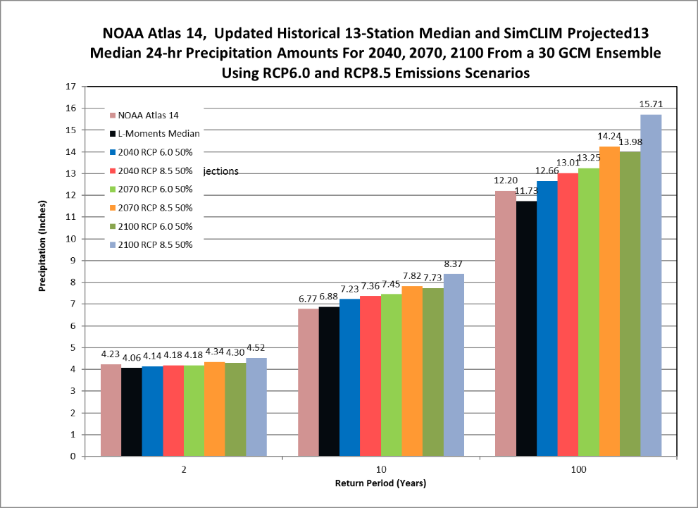
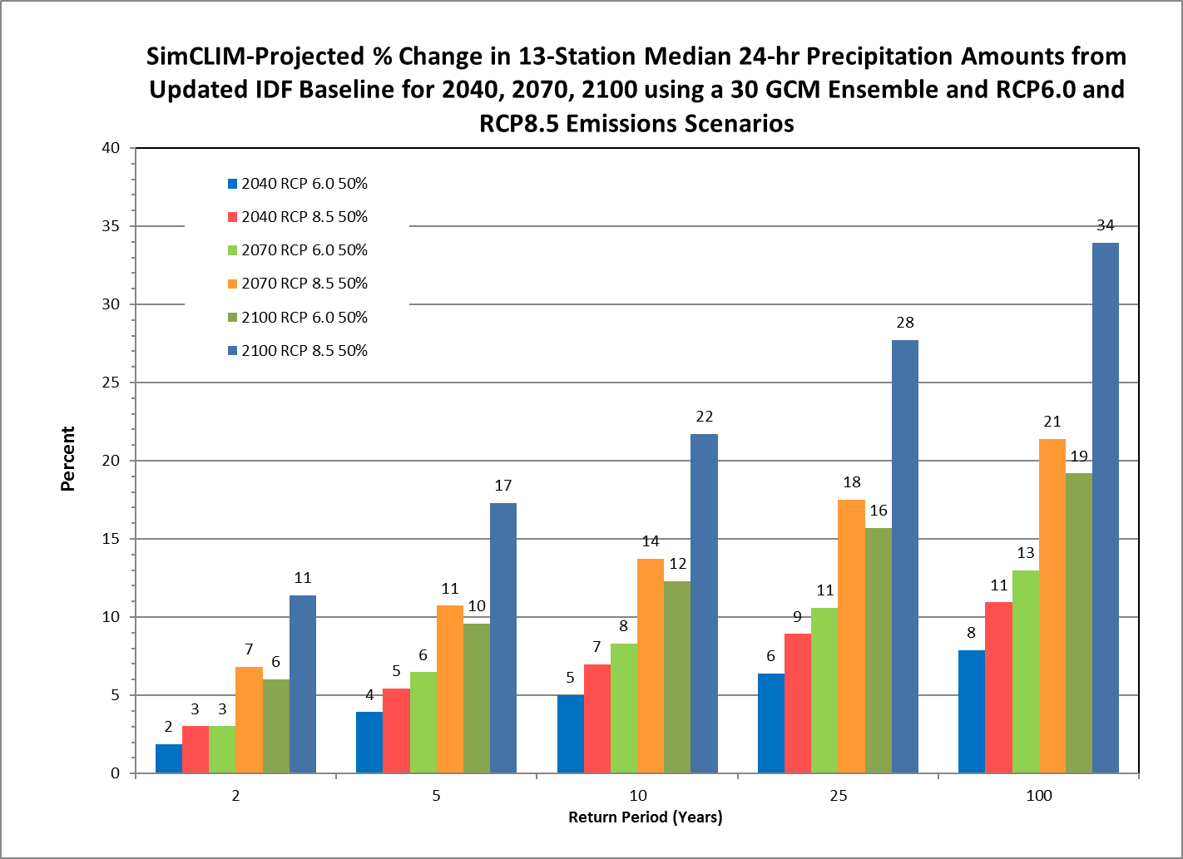
Rainfall Intensity Duration Frequency (IDF) Projections
Median of Global Climate Model Projection Ensemble

Slide 12
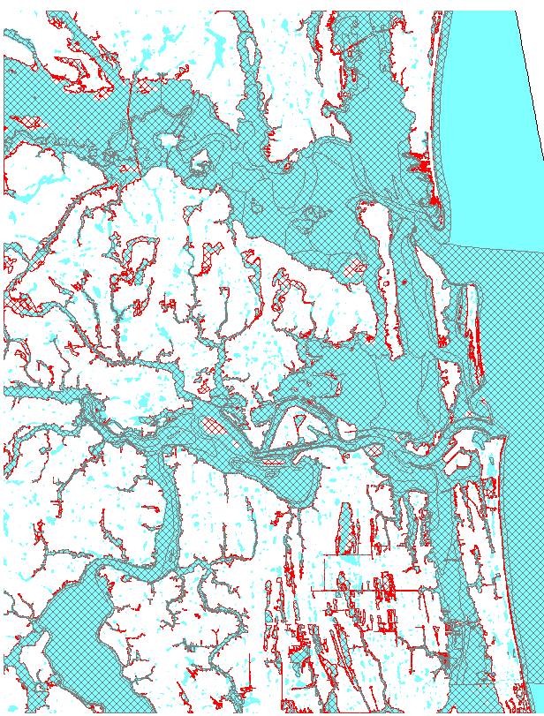
Flood Modeling

Slide 13
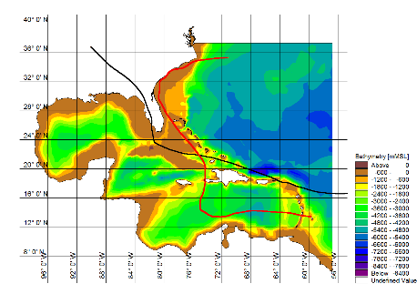
Surge Modeling Performed of Historical Hurricane Events Matthew and Irma
Hurricane Irma, 2017
Hurricane Matthew, 2016
Note: “Predicted Tide” refers to NOAA prediction of astronomical tide based on harmonic analysis of measured water level data, without meteorological disturbances such as surge.
Image: Bathymetry of Gulf of Mexico, Caribbean and Eastern Atlantic, with Hurricane Matthew and Irma tracks.

Slide 14
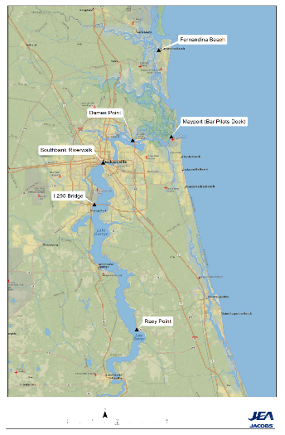
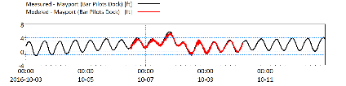
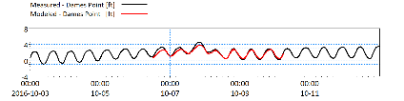
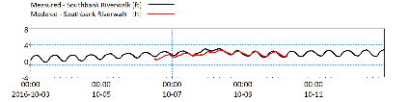
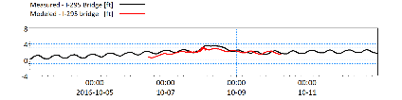
Calibration – Historical Event:
Hurricane Matthew

Slide 15
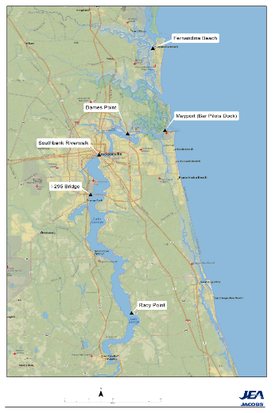
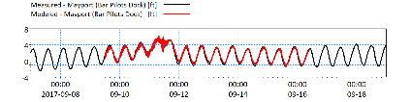
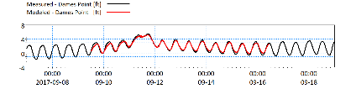
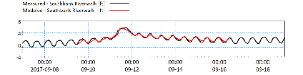
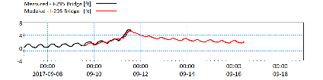
Validation – Historical Event:
Hurricane Irma

Slide 16
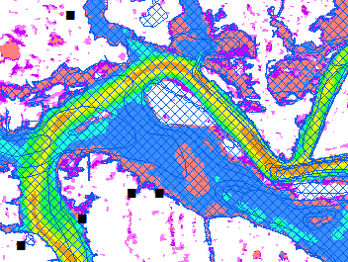
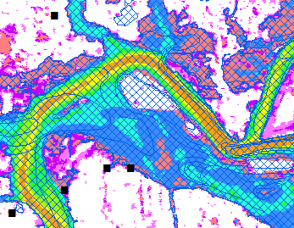
100-year Storm: Base Scenario versus Scenario 1
2040, Rain (lower emissions – RCP6.0), SLR (NOAA intermediate), and Storm Surge
Facilities in Floodplain
All JEA Facilities:
  Current: 210 (12.6%)
  Scenario 1: 288 (16.9%)
Priority JEA Facilities:
  Current: 90 (50%)
  Scenario 1: 91 (50%)
Baseline: 100 year
Scenario 1, 2040: 100 year

Slide 17
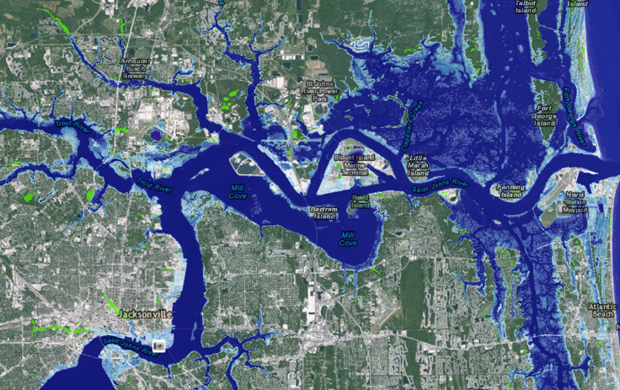
Vulnerability Assessment:
Current and Future Flood Hazards
Relative Sea Level Rise: 2050

Slide 18
Vulnerability Assessment
Vulnerability = (Exposure + Sensitivity)
(Adaptive Capacity + Redundancy)

Slide 19
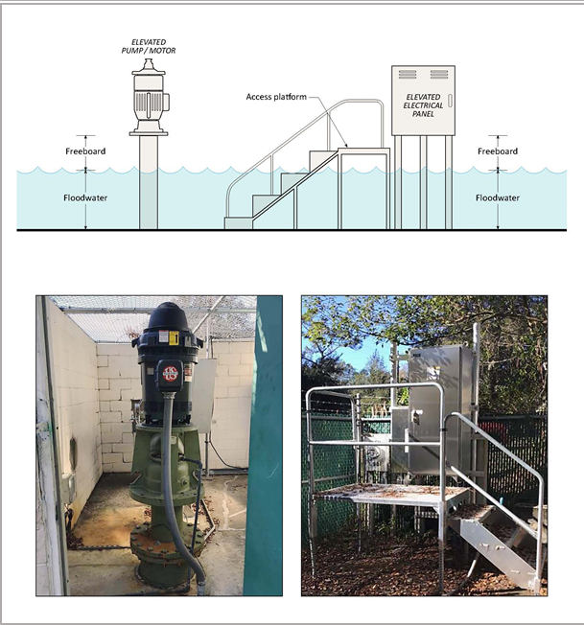
Adaptation Strategy Development

Slide 20
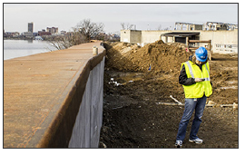
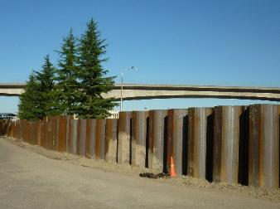
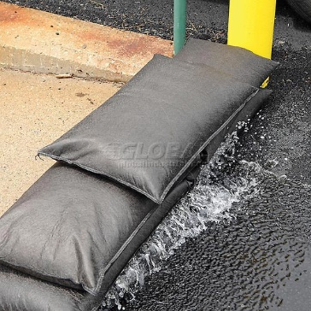
Adaptation Strategies
Strategy | Resilience Level
No Action | No Protection
Sandbagging | Low
Temporary Barriers | Moderate
Seal Building/ Control Room | Moderate
Construct Static Barrier | High
Flood-proof Equipment | High
Elevate Equipment | Very High
DC Water Flood Wall
Source: Umair Irfan, eenews.net
Tacoma WA Central Plant Flood Wall

Slide 21
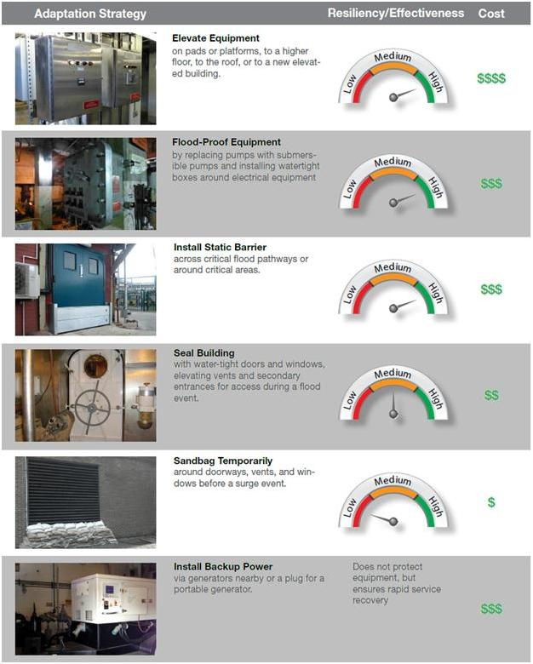
Applying Adaptation Strategies
Elevate Equipment
on pads or platforms, to a higher floor, to the roof, or to a new elevated building.
Focus on strategies for high LOS assets at risk of flooding today, focused on three categories:
  Elevating, Hardening and Perimeter Barriers
Develop strategies for individual assets and asset groups, i.e. buildings.
  Building-level strategy for at risk buildings preferred over asset level strategies.
Flood-Proof Equipment
by replacing pumps with submersible pumps and installing watertight boxes around electrical equipment.
Install Static Barrier
across critical flood pathways or around critical areas.
Seal Building
with water-tight doors and windows, elevating vents and secondary entrances for access during a flood event.
Sandbag Temporarily
around doorways, vents, and windows before a surge event.
Install Backup Power
via generators nearby or a plug for a portable generator.
Does not protect equipment but facilitates rapid service recovery.

Slide 22
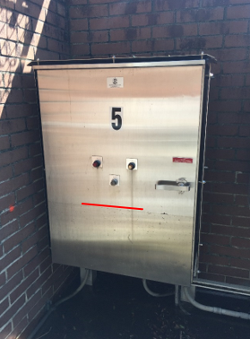
Risk Assessment, Economic &
Benefit Cost Analysis

Slide 23
Risk Analysis
Risk = likelihood x consequence of damages
Likelihood = probability of hazard occurrence
  Interpolated from flood modeling scenarios
  Assumed to increase over time due to climate change
Potential consequences:
  Direct damage to JEA’s facilities and assets, based on replacement cost, or
  Indirect consequences to JEA’s customers (business losses based on assumed period of service interruption)

Slide 24
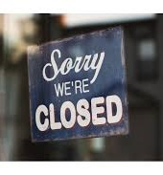
Economic Analysis
Business loses were calculated for all customers for each JEA facility.
If a business loses water or wastewater service, or has a sewer back-up, it closes.
Monetized risk avoided are included across asset service life to evaluate full benefits of investment.

Slide 25
Risk and Return on Investment Results
Relative Sea Level Rise: 2050

Slide 26
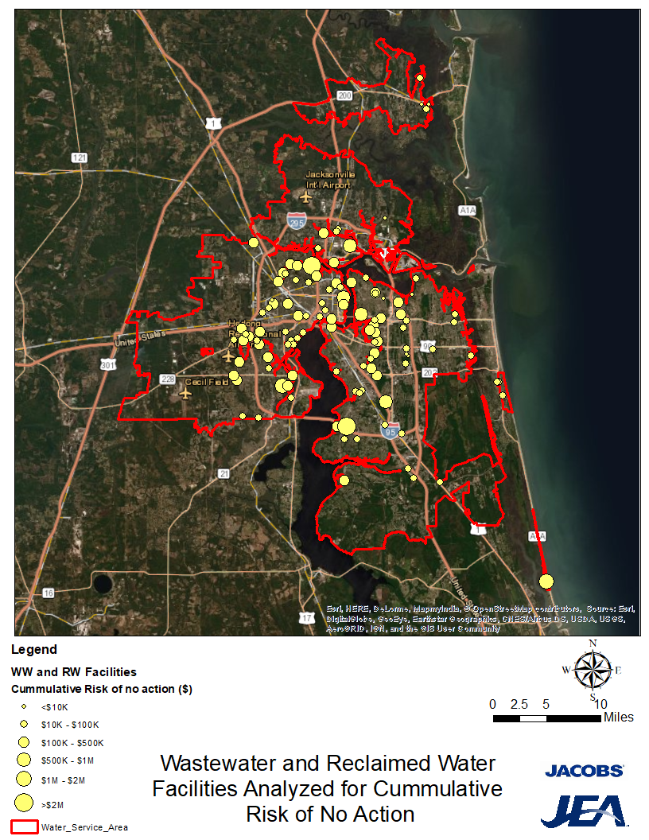
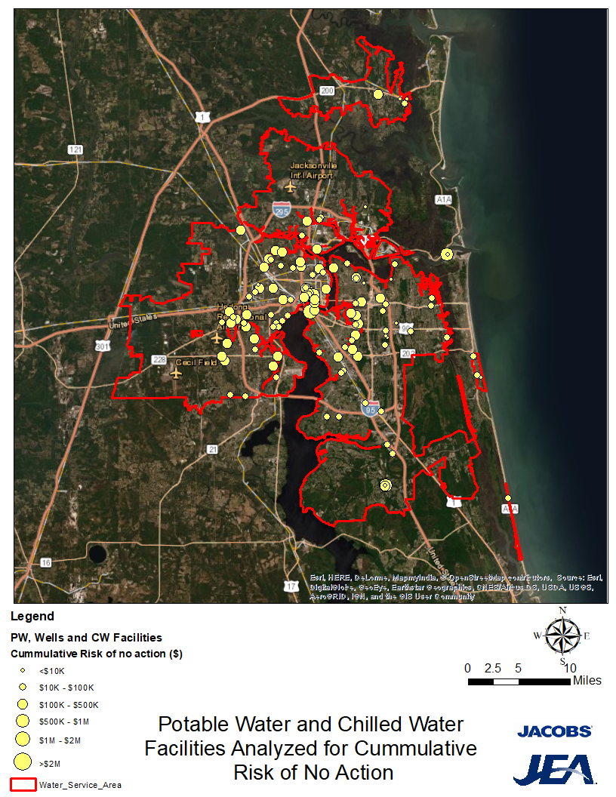
Monetized Risk Map for Priority Facilities

Slide 27
Monetized Risk Summarized by Facility Type
(Direct Physical Damage Only)

Slide 28
Monetized Risk and Risk Scores
(Combined Physical Asset and Business Risk)

Slide 29
Resilience Investments were also ranked based on
Return on Investment for Different Levels of Flood Control

Slide 30
Return on Investment and ROI Scores
(Combined Physical Asset and Business Risk)

Slide 31
Top 20 CIP Projects
Revised since May draft report
Full list to be provided in revised report
Ranking | Facility Name | Priority | Project Type
1 | Arlington East WRF | High | Electrical and I&C upgrades; Capacity upgrades; Effluent PS rehabilitation/upgrades
2 | Buckman WRF | High | Flood resilience upgrades; Electrical and I&C upgrades; Capacity upgrades
3 | Southwest WRF | Medium-High | Flood resilience upgrades; Electrical and I&C upgrades; Capacity upgrades
4 | Monterey WRF | Medium-High | Flood resilience upgrades; Electrical and I&C upgrades; Electrical switchgear replacement/ generator addition, influent backup pump, and containment pond
5 | 2045 Utah Avenue | Medium-High | Flood resilience upgrades
6 | Buckman WRF Outfall | Medium-High | Rehabilitation of outfall pipe
7 | River Oaks Potable Repump Station | Medium-High | Electrical and I&C upgrades
8 | Main Street WTP | Medium-High | Flood resilience upgrades; Electrical and I&C upgrades
9 | Hendricks WTP | Medium-High | Flood resilience upgrades; Electrical and I&C upgrades
10 | 210 Hollybrook Avenue | Medium-High | Flood resilience upgrades; Capacity upgrades
11 | 7834 Holiday Road South | Medium-High | Flood resilience upgrades; Capacity upgrades
12 | 1023 Laura Street North | Medium-High | Flood resilience upgrades
13 | Main Street WTP Well No. 1 | Medium-High | Flood resilience upgrades
14 | Mayport WTP | Medium | Flood resilience upgrades
15 | 8617 Western Way | Medium | Flood resilience upgrades
16 | Main Street WTP Well No. 10 | Medium | Flood resilience upgrades
17 | Arlington Potable Booster Pump Station | Medium | Electrical and I&C upgrades
18 | Ponce de Leon WWTP | Medium | Flood resilience upgrades
19 | St. John’s Forest WTP 1 | Medium | Flood resilience upgrades
20 | 5301 Evergreen Avenue | Medium | Flood resilience upgrades

Slide 32
Next Steps
Finalize and submit System Resilience Plan report
Final workshop
Recommended next steps
  Develop CIP implementation plan for Resilience projects
  Update JEA design standards for resilience
  Continue resilience requests for new CIP projects
  Staff training
  Consider ongoing contracted services to address commonly found issues:
    Antenna grounding
    Antenna support
    Lightning protection
    Control panel cable management
    E-stop installation
    Emergency entry gate/access

Slide 33
Questions?

